Slide 1
Wesley Web
Instructions for WesleyWeb

Slide 2
Go to our website, www.wesleyseminary.edu
Click on current students
Click on Login
If you forget your password, please contact SolutionWorx at 703-961-1840, x2.

Slide 3
Once you are logged in you have the option to:
Check Blackboard
Check Student Email
Check WesleyWeb
Logout
To register for classes, please click on WesleyWeb.

Slide 4
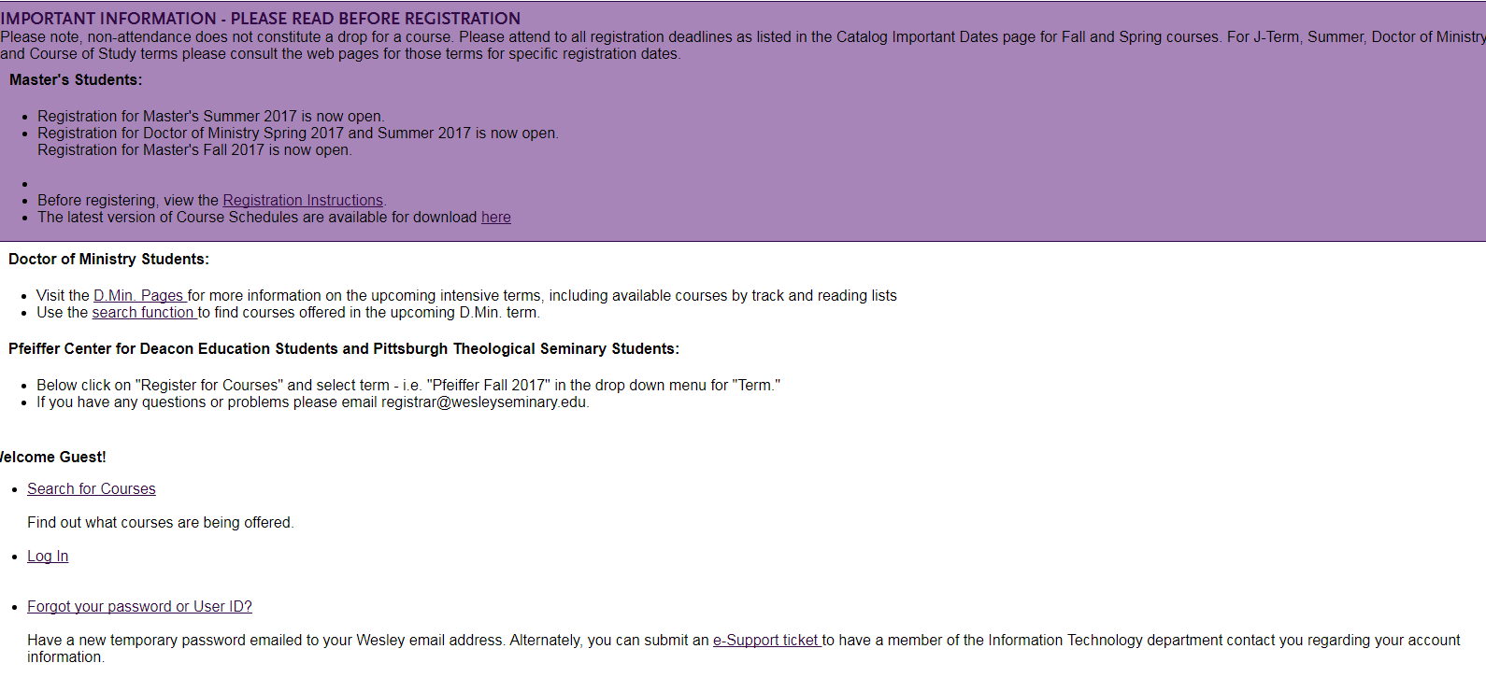
Once you are logged in you have to log in again to reach WesleyWeb.

Slide 5
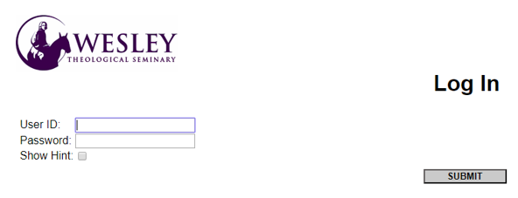
Enter user ID and password again, then click on submit

Slide 6
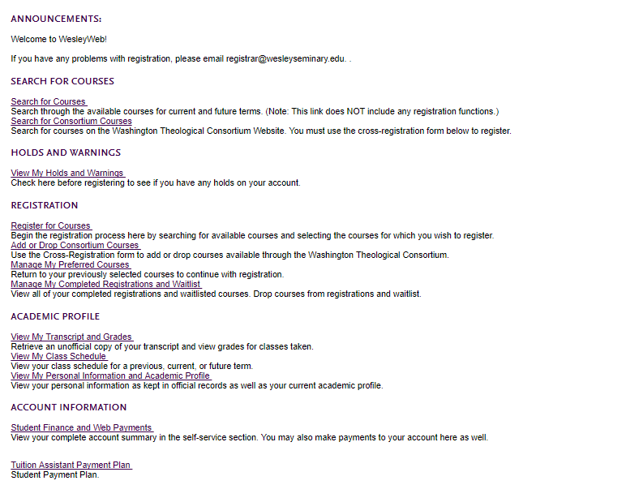
This is to search for courses only.
This is where you register for courses.
View transcripts or schedule
Make payment

Slide 7
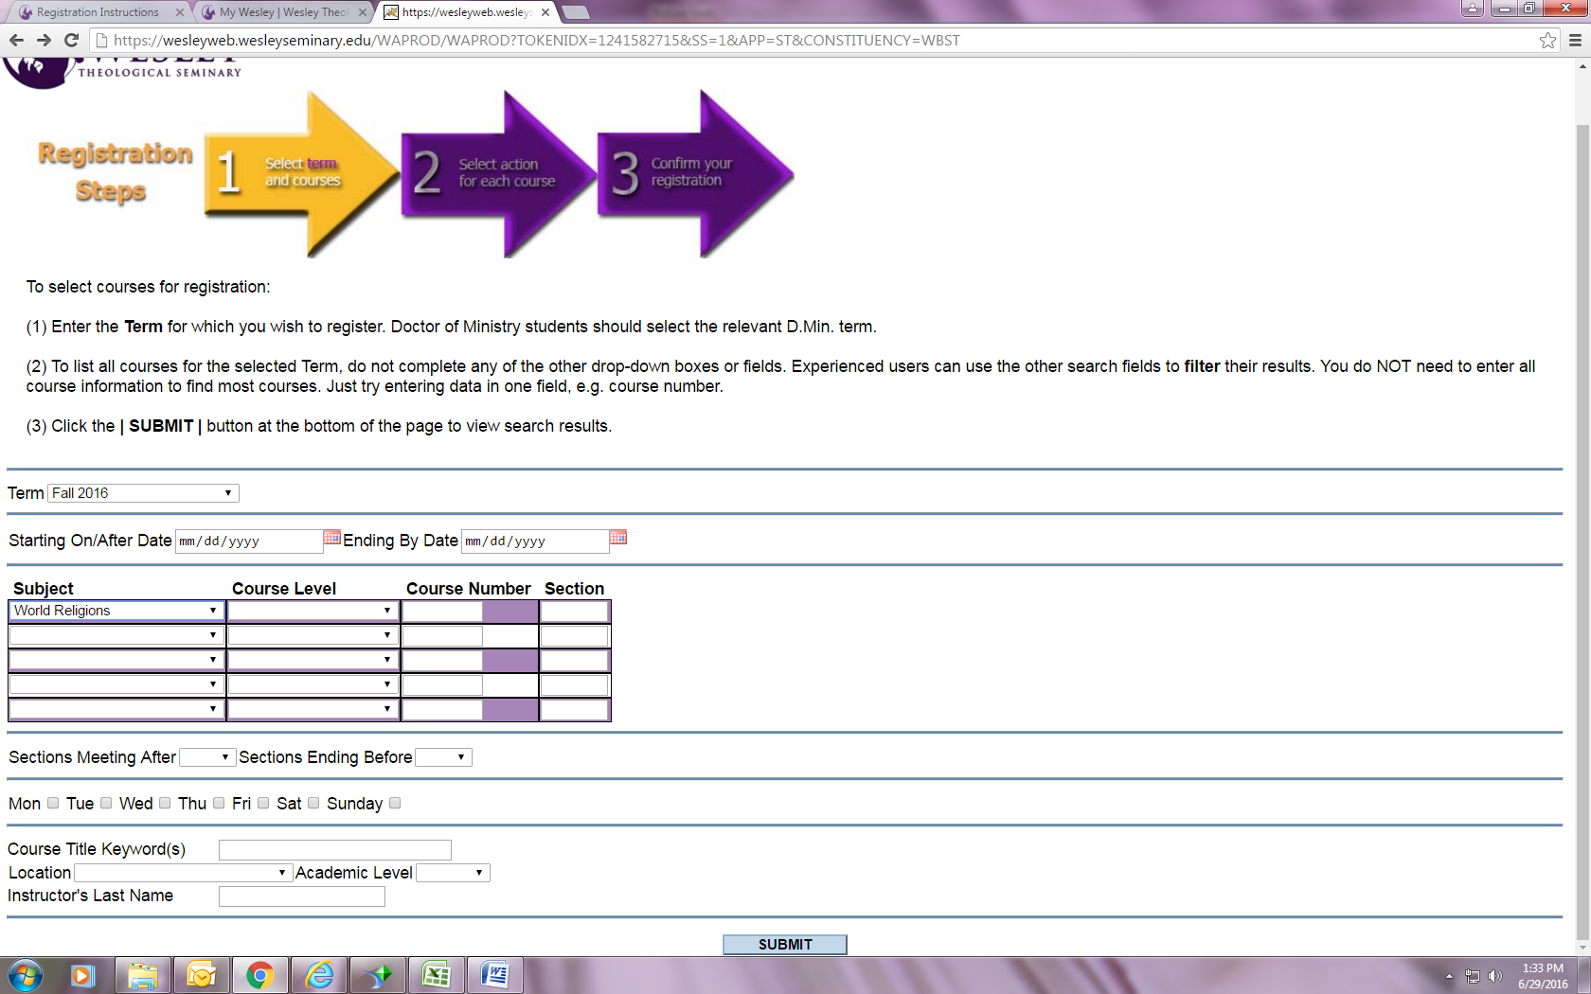
Select the appropriate term
Select the subject of the class you want to take. Do not enter any additional parameters. Click on submit.
CLICK ON SUBMIT

Slide 8
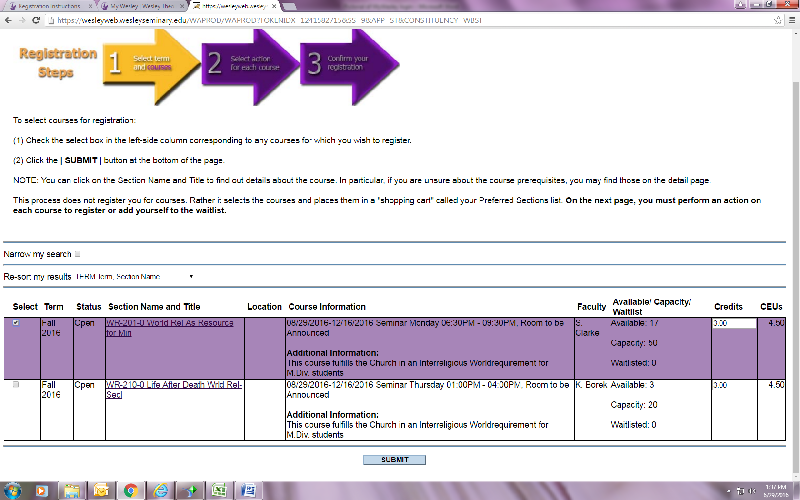
Review the dates of the class and the instructor to ensure this is the correct class and check the box. Hit Submit.

Slide 9
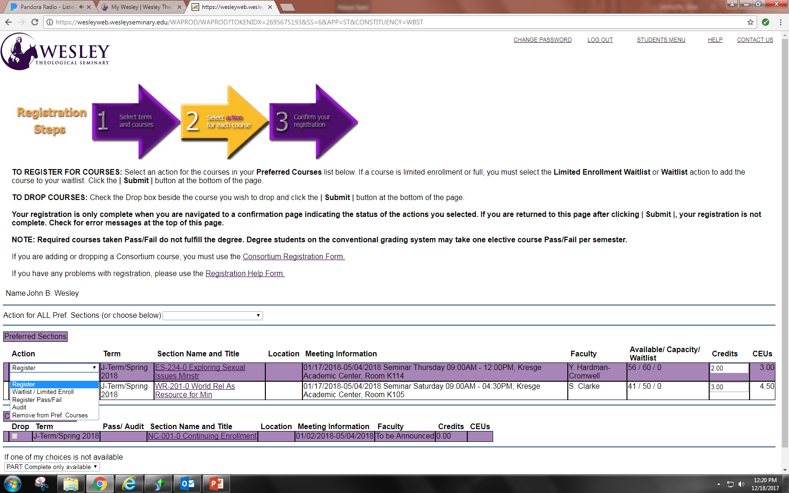
From the drop down menu, select either REGISTER, WAITLIST, REGISTER PASS/FAIL, AUDIT, or REMOVE FROM PREF COURSES before you hit the submit button. Then hit SUBMIT to complete registration.

Slide 10
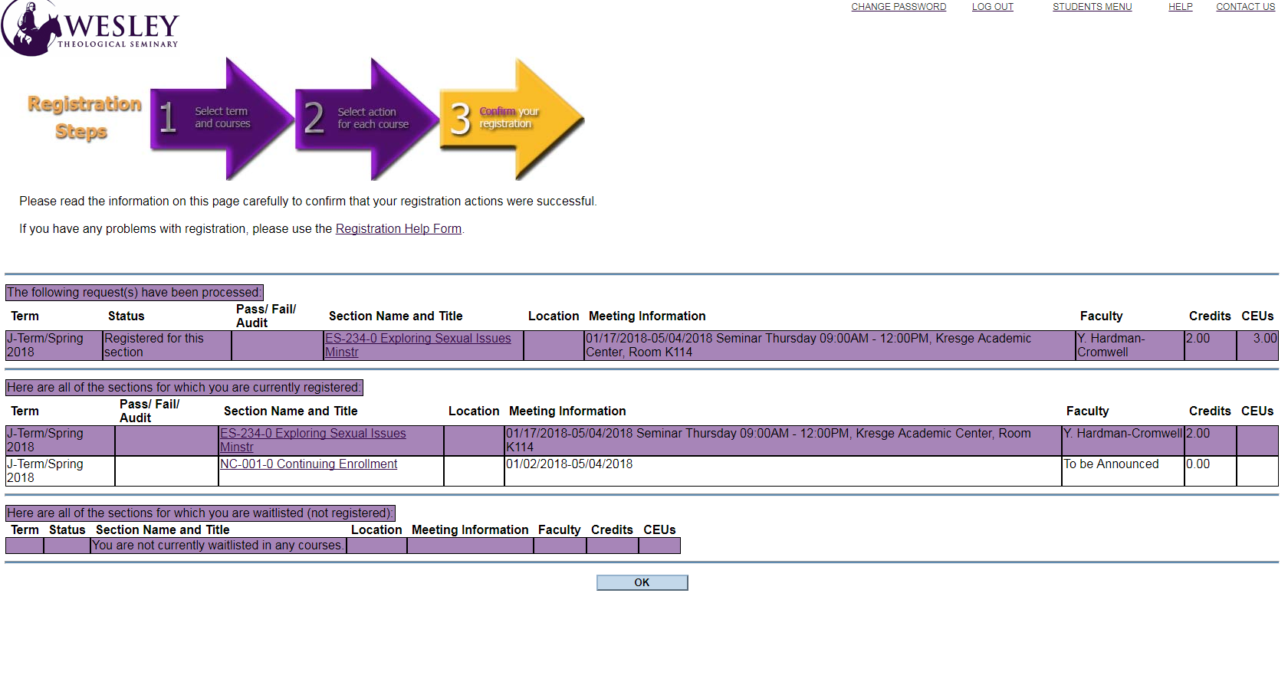
Make sure you hit “OK” to complete registration.

